Slide 1
Artificial Neural Network-Based Robotic Control
Master’s Thesis
Justin Ng
June 8, 2018
Committee Chair Committee Member Committee Member | Andrew Danowitz, Ph.D. Xiao-Hua Yu, Ph.D. Fred W. DePiero, Ph.D.

Slide 2
Outline
Outline
Teaser
Introduction/Motivation
Background
Solution
Implementation
Results
Future work and conclusions

Slide 3
Outline
Outline
Teaser
Introduction/Motivation
Background
Solution
Implementation
Results
Future work and conclusions

Slide 4
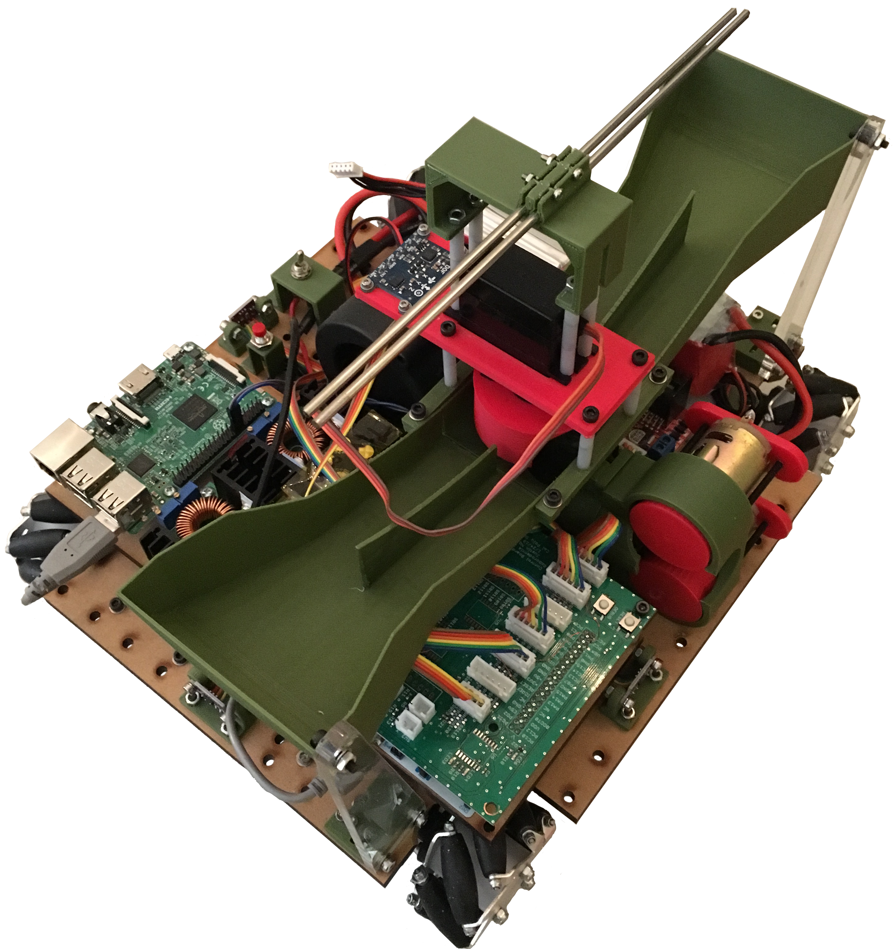
Teaser
Reinforcement learning applied to continuously-controlled robotics.
Controller sets robot’s position and orientation in the environment.

Slide 5
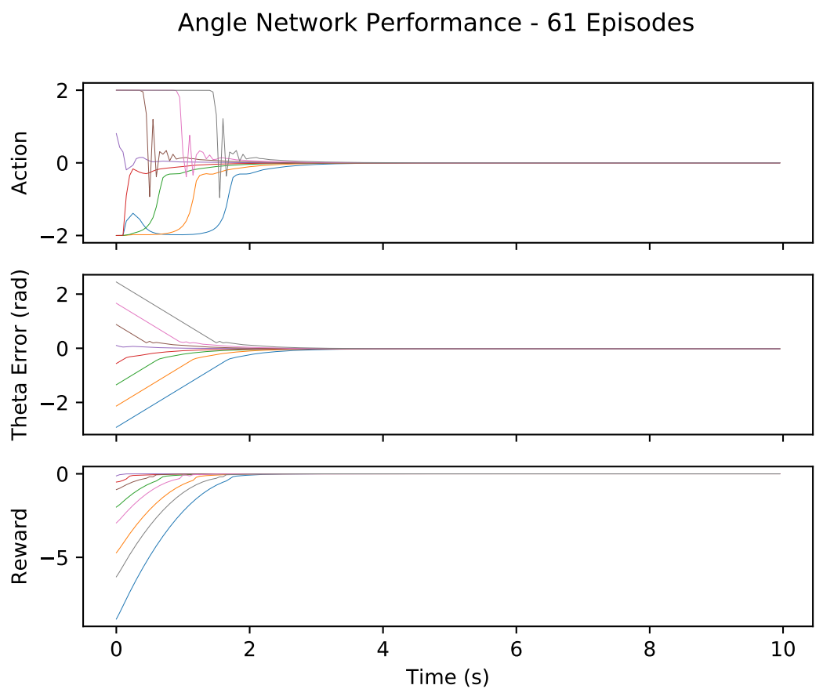
Teaser
Uses deep deterministic policy gradients method developed by DeepMind.
Model-free, actor-critic algorithm implemented with artificial neural networks.

Slide 6
Outline
Outline
Teaser
Introduction/Motivation
Background
Solution
Implementation
Results
Future work and conclusions

Slide 7

Cal Poly Roborodentia
Annual intramural robotics competition.
Fully autonomous robots.
Different game every year.
Source: http://roborodentia.calpoly.edu/
Notes:
Introduce Roborodentia.

Slide 8
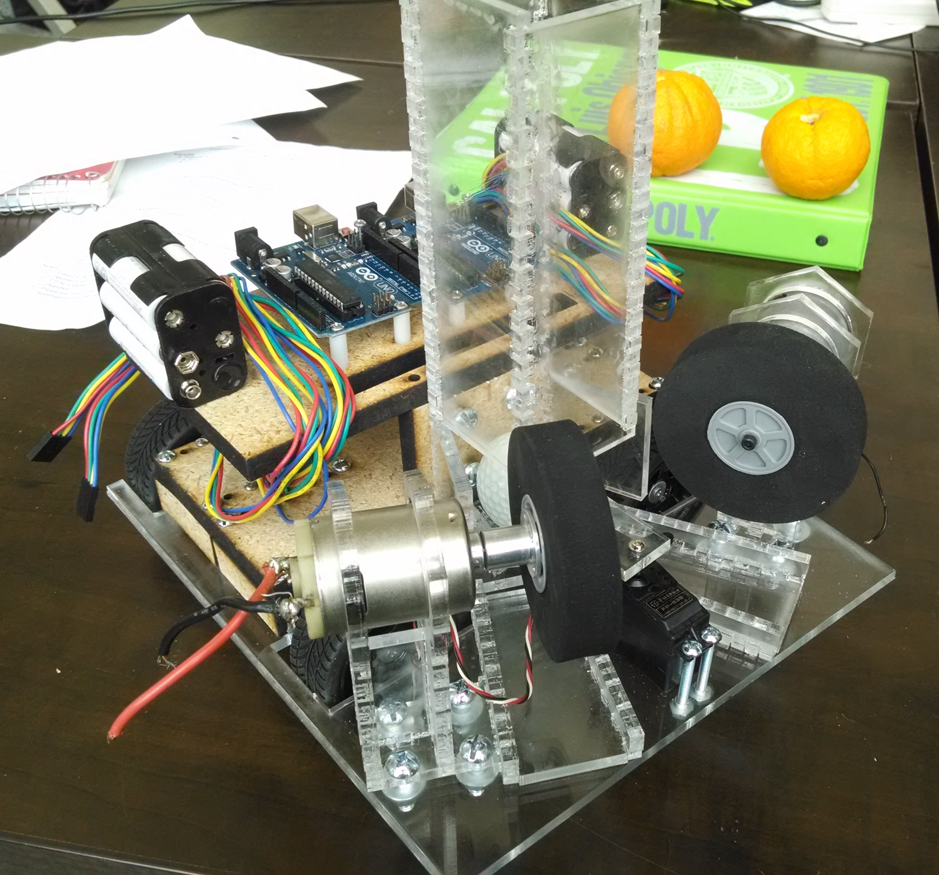
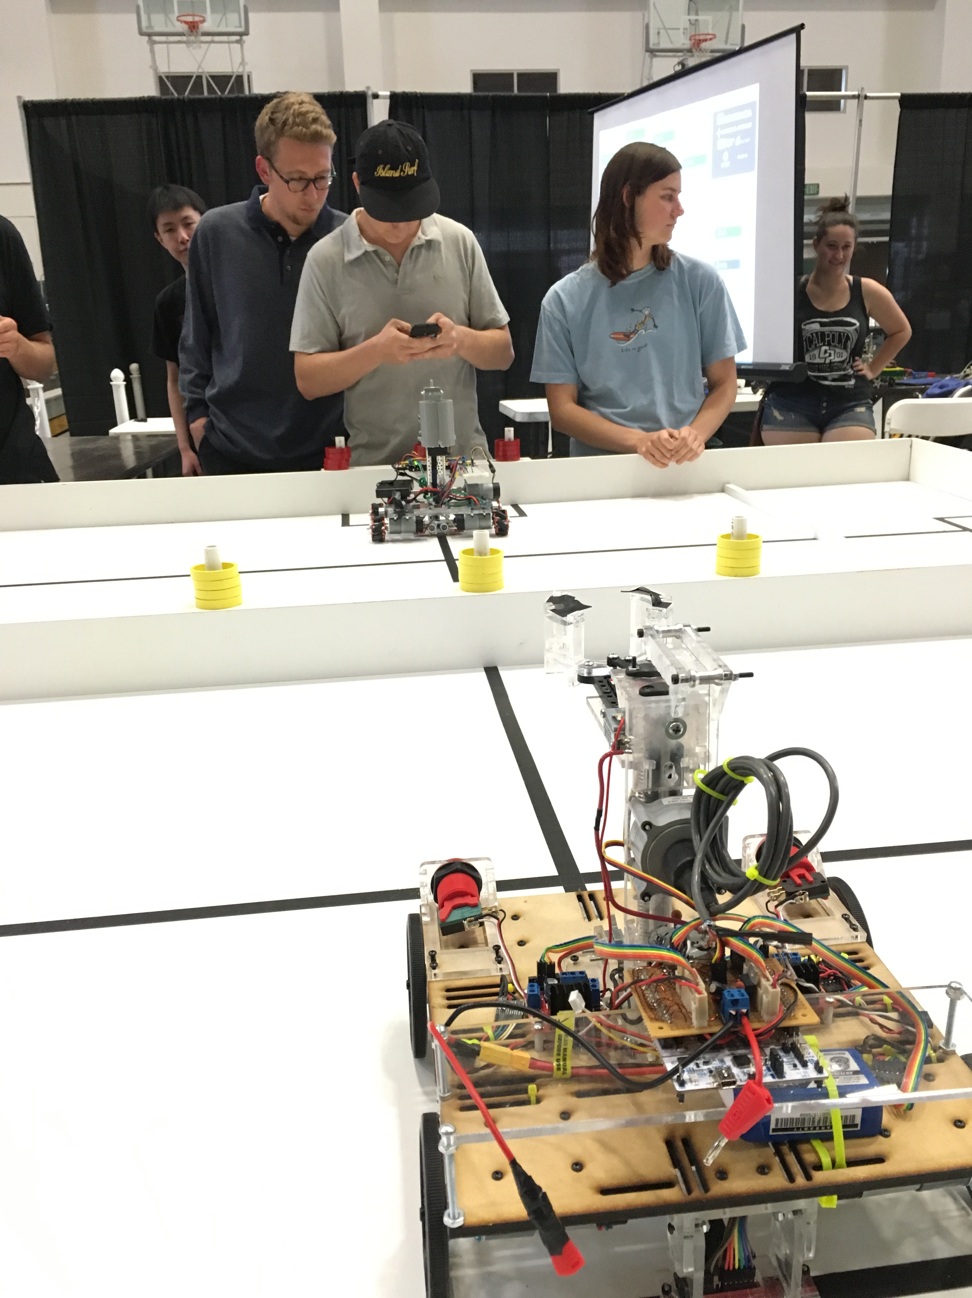
Previous Roborodentia Entries

Slide 9
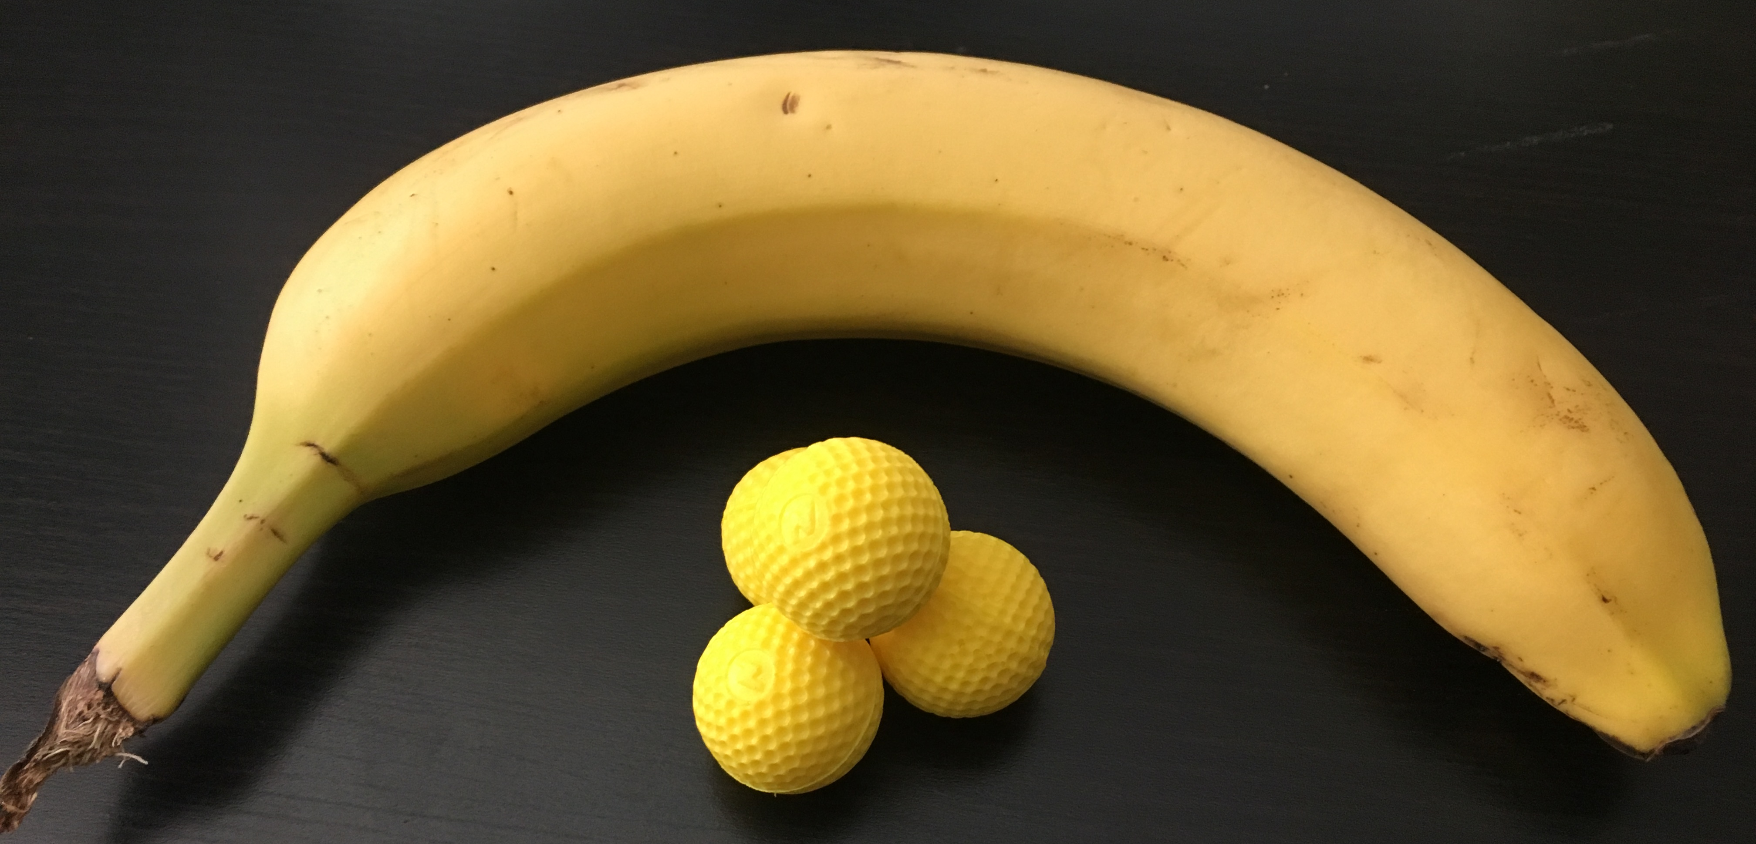
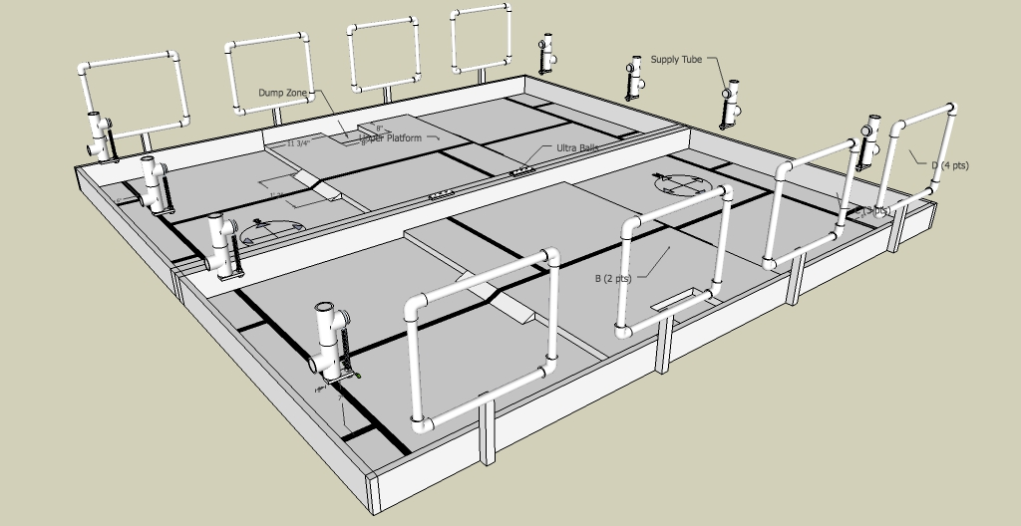
2018 Cal Poly Roborodentia
Robots obtain Nerf Rival balls from supply tubes.
Shoot balls into nets to score points.
Source: http://roborodentia.calpoly.edu/
Notes:
Introduce Roborodentia.

Slide 10
2018 Entry
Built from scratch.
Contains numerous custom parts and electronics.

Slide 11
Problem Statement
Use machine learning to control robot’s position and orientation in the field with continuous state and action spaces.
Receive state information from sensors and output four motor voltages to drive robot wheels.

Slide 12
Outline
Outline
Teaser
Introduction/Motivation
Background
Solution
Implementation
Results
Future work and conclusions

Slide 13
Reinforcement Learning
RL:
Subset of machine learning.
Solves control and action selection problems
“In-between” supervised and unsupervised learning.
Supervised learning: perform classification
Unsupervised learning: data clustering, find underlying patterns.

Slide 14
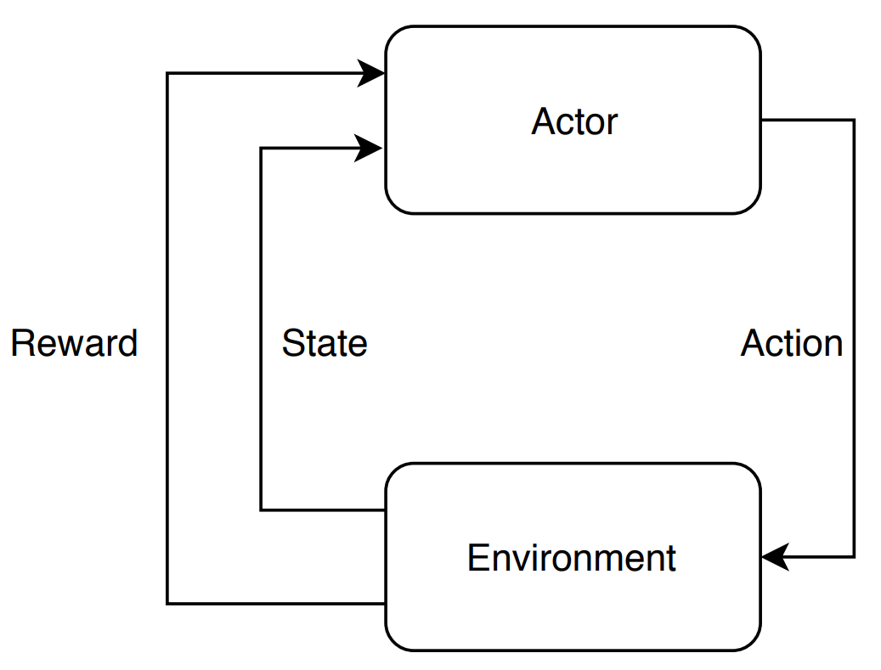
Reinforcement Learning Elements
Environment
Actor/agent
Reward/return (R, r)
Policy (π)
Value function (V, Q)
Sometimes a model
Notes:
Environment The various states and associated rewards through which the actor navigates.
Actor/Agent Chooses actions based on a policy.
Reward/return (r) A number emitted by the environment denoting ”goodness” of the state
Policy (π) The strategy by which the actor chooses its actions, e.g. random, exploratory, greedy.
Value (V) The expected long-term discounted reward of a state.
Model allowing prediction of the next state from the current state and action

Slide 15
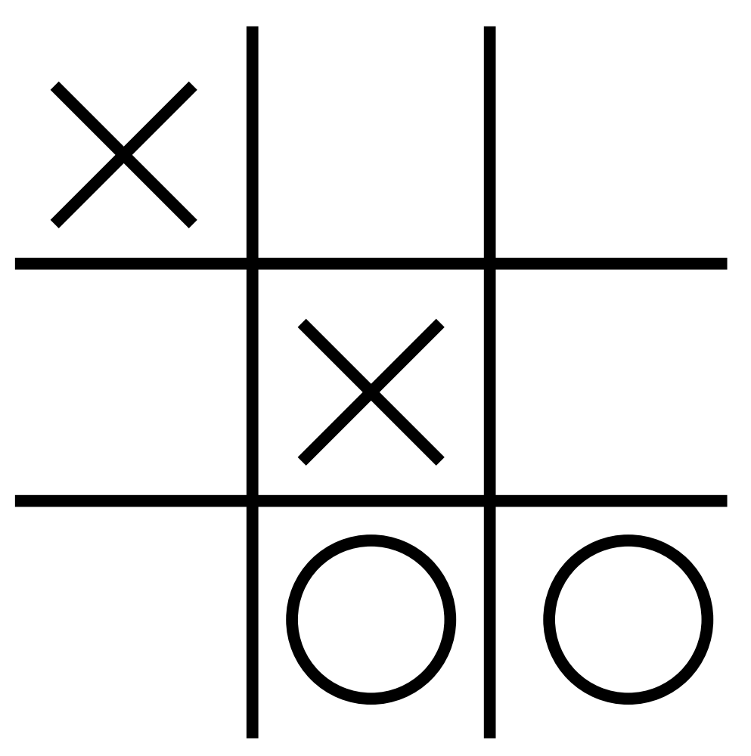
Reinforcement Learning Elements – Tic Tac Toe Example
Environment
Actor
Action (a_{k})
Reward (r_{k})
State (s_{k})
Transition [s_{k}, a_{k}, r_{k}, s_{k+1}]

Slide 16
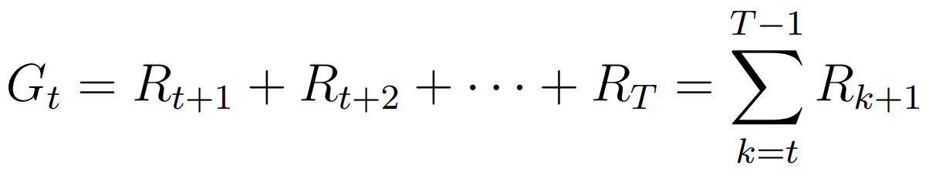
Long-term reward G_{t}
Calculated as sum of all future rewards.
Usable in RL problems with a definitive end.
Actor’s goal to maximize G_{t}.

Slide 17
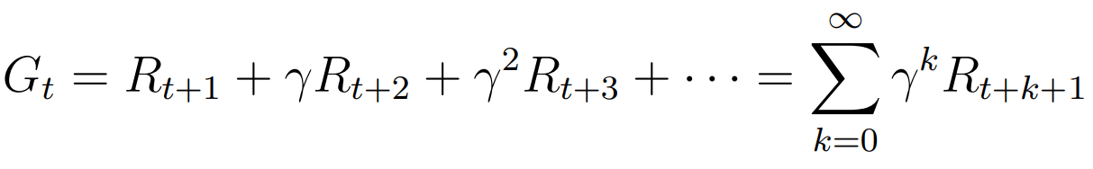
Long-term discounted reward G_{t}
Calculated as sum of all future rewards weighted by a discount factor γ.
Allows G_{t} to converge for environments with no maximum time step.
Sets algorithm’s “outlook” from myopic to far-sighted.
Notes:
Gamma ranges from 0 to 1
1 is

Slide 18
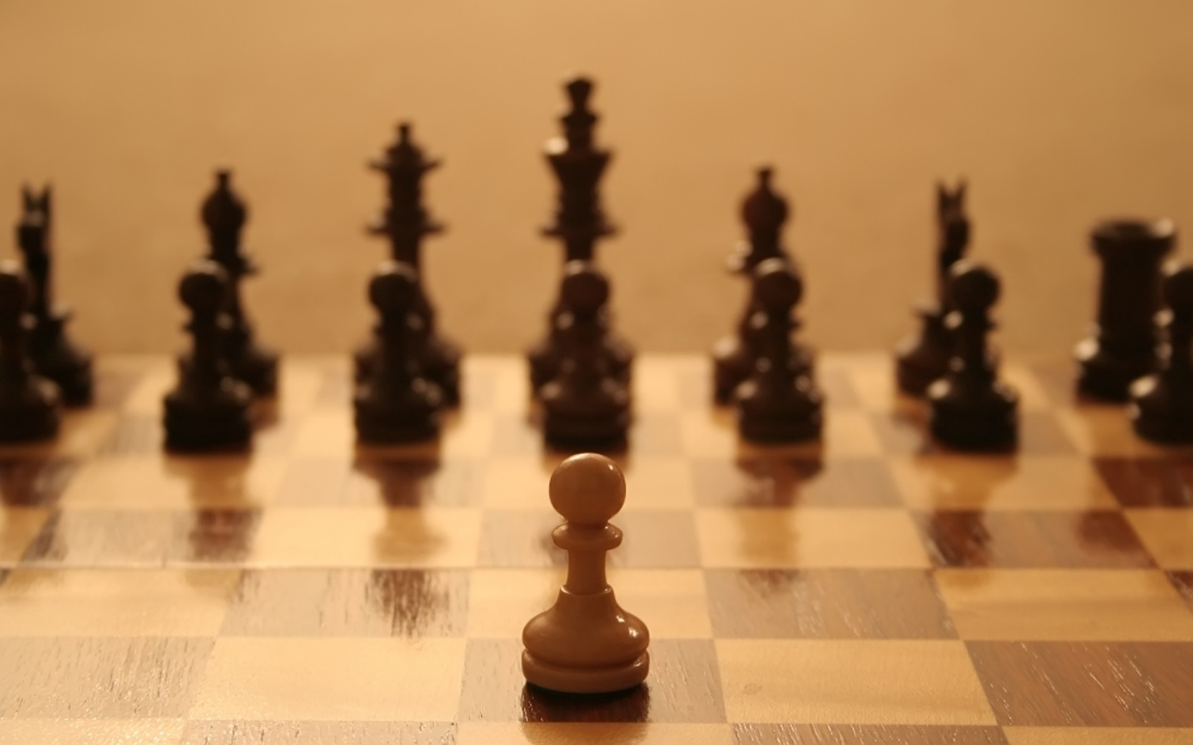
Value Functions
Indicates the long-term reward expected from a state.
Even if a state only has a small immediate reward, it may possess high value since it leads to high reward states.
Source: https://arcdigital.media/the-trans-pacific-partnership-
a-pawn-sacrifice-in-a-global-game-22e62cdf775
Notes:
Imagine a game of chess. Sacrificing a piece may seem like a negative action but may open other opportunities.

Slide 19
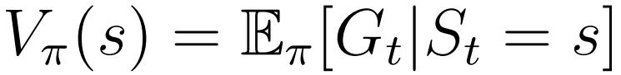
Value Functions
Expected long-term reward as a function of the state under a certain policy π.
Notes:
For the game of tic tac toe, there are values for each of 19,683 states.

Slide 20
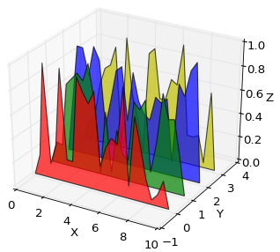

Q-Functions
Expected long-term reward as a function of the state and action under a certain policy π.
Represents the quality of an action in a particular state.
Source: https://matplotlib.org/1.3.0/mpl_examples
/mplot3d/polys3d_demo.png
Notes:
For the game of tic tac toe, there are values for each of 19,683 states.

Slide 21
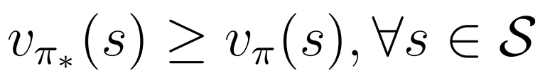
Policies
Optimal (π∗): produces greater value for every possible state than any other policy (π).
Greedy: take action with highest value/Q-value.
Random: pick a random action.
ε-greedy: pick greedy action with probability 1- ε and random action with probability ε.

Slide 22
On-Policy vs. Off-Policy
On-policy algorithms: learn the policy followed by the actor.
Off-policy algorithms: learn a policy different from the one followed by the actor.
Exploration vs. Exploitation
Notes:
On-policy: typically less efficient.
Off-policy: more efficient at exploring but less likely to converge.

Slide 23
RL Algorithms
Q-Learning
State-Action-Reward-State-Action (SARSA)
Deep Q-Network (DQN)
Stochastic Policy Gradients (PG)
Deterministic Policy Gradients (DPG)
Deep Deterministic Policy Gradients (DDPG)

Slide 24
Q-Learning
Model-free, off-policy algorithm that estimates the Q-function of the environment.
Q-function represents the ”quality” of every possible action in every possible state.
Notes:
For example, imagine a game of tic-tac-toe as shown in Figure 6.2. Each of the nine spaces can take one of three values (blank, X, or O) so the game has 39 = 19, 683 possible states (although some states are not achievable as the game would end once a player gets three in a row). Given a particular state, the Q-function returns the quality, i.e. predicted goodness, of each possible action the player could take. Therefore, the optimal action to take is simply the one with the highest Q-value.

Slide 25

Tabular Q Methods
 |  | Action
 |  | Put X in top left | Put X in top middle
State |  | -5.8 | -4.3
 |  | 3.3 | -5.2
Tabular Q-learning methods use a 2-D matrix to represent the Q-function.
Iteratively calculated using the Bellman equation.
Notes:
Explain max_a’, s’, a’

Slide 26

Tabular Q Iterative Update
Iteratively calculated using the Bellman equation.
Learning rate α improves convergence.

Slide 27
RL Algorithms
Q-Learning
State-Action-Reward-State-Action (SARSA)
Deep Q-Network (DQN)
Stochastic Policy Gradients (PG)
Deterministic Policy Gradients (DPG)
Deep Deterministic Policy Gradients (DDPG)

Slide 28

State-Action-Reward-State-Action (SARSA)
Model-free, on-policy algorithm similar to Q-learning.
Updates Q based on next state and action instead of greedy action:
Compare to Q-learning update:

Slide 29
Q-Learning and SARSA Issues
Not practical for large state or action spaces.
(# of Q table elements) = (# of states) x (# of actions)
Not practical for continuous state or action spaces.
Cannot generalize learnings. Must explore all (state, action) combinations. Expensive!

Slide 30
RL Algorithms
Q-Learning
State-Action-Reward-State-Action (SARSA)
Deep Q-Network (DQN)
Stochastic Policy Gradients (PG)
Deterministic Policy Gradients (DPG)
Deep Deterministic Policy Gradients (DDPG)

Slide 31
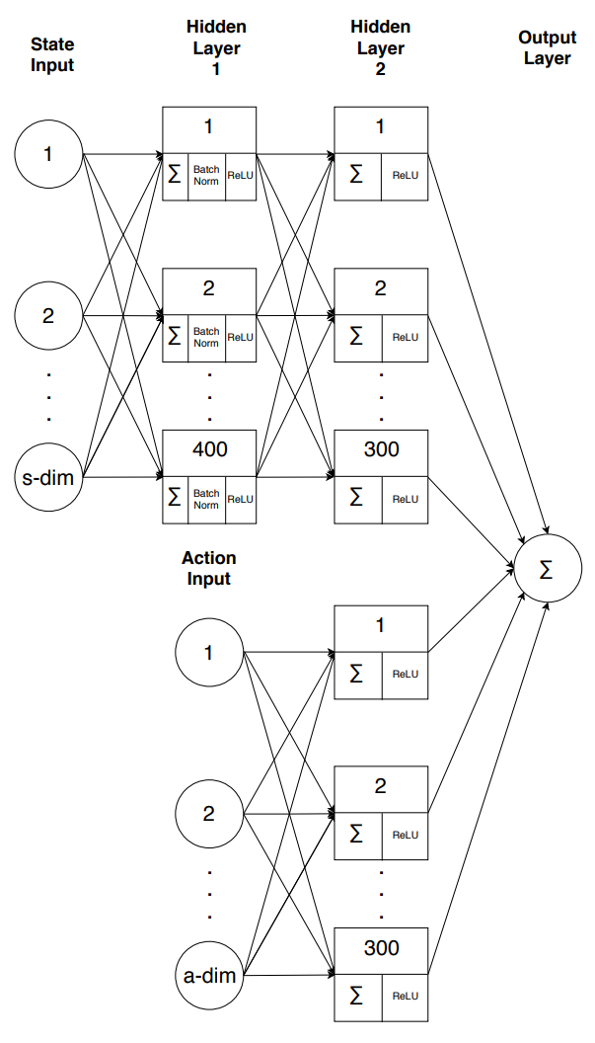
Deep Q-Network (DQN)
Model-free, off-policy method published by Mnih et al. in “Human-level control through deep reinforcement learning”.
Can determine Q for continuous state/action spaces.
Replace the Q table with artificial neural network (ANN) to allow generalization.

Slide 32
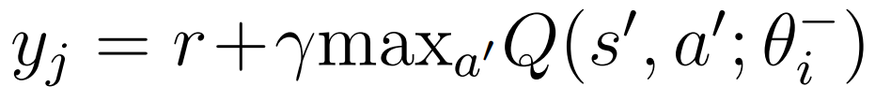

DQN ANN
Inputs: state and action.
Outputs: Q-value.
Target Q-value based on Bellman Equation:
Loss function:
Notes:
Explain theta^-

Slide 33
Two Critical DQN Learnings
Experience replay buffer
Records transitions.
Randomly sampled mini-batches remove time correlation.
Experience reuse.
Target network
Identical but separate Q-network.
Time delay between Q-network weight updates and policy change reduces policy instability.
Notes:
For example, using a 64 transition mini-batch, the network randomly samples 64 transitions from the experience replay buffer and trains the network Q with 64 iterations as in 6.7. After, the target network Qˆ clones the weights θi from Q and the process repeats.
Policy still uses discrete actions.

Slide 34
RL Algorithms
Q-Learning
State-Action-Reward-State-Action (SARSA)
Deep Q-Network (DQN)
Stochastic Policy Gradients (PG)
Deterministic Policy Gradients (DPG)
Deep Deterministic Policy Gradients (DDPG)

Slide 35
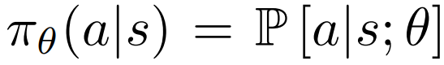
Stochastic Policy Gradient Method (PG)
Model-free, on-policy algorithm.
Find optimal policy directly without value or Q-function.
Policy produces continuous actions!
Policy implemented with a parametric probability distribution:
Notes:
Used by AlphaGo to defeat Fan Hui (2015) and Lee Sedol (2016).

Slide 36
Stochastic PG Premise
Get the current state.
Stochastically choose an action from distribution P[a|s; θ].
Record the reward.
If reward is “good”, change θ to make the action more likely.
Iterate many times so actor only takes “good” actions.

Slide 37
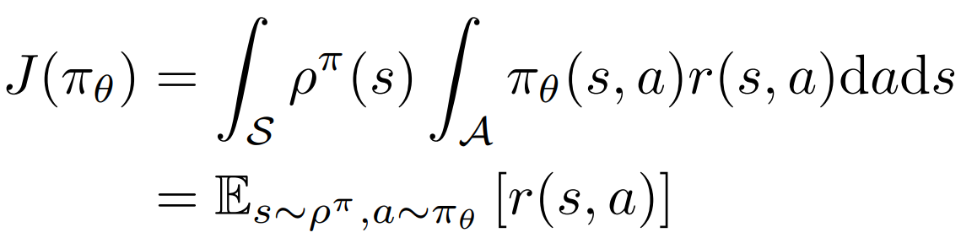
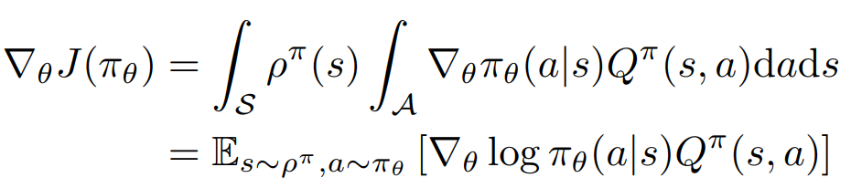
Policy Gradient as Derived by Sutton et al.
Objective function:
Policy gradient:
Source: R. Sutton, D. McAllester, S. Singh, and Y. Mansour. Policy Gradient Methods for Reinforcement Learning with Function Approximation, pages 1057–1063. 1999.
Notes:
Gradient with respect to each theta parameter tells you which way to push the parameter.

Slide 38
RL Algorithms
Q-Learning
State-Action-Reward-State-Action (SARSA)
Deep Q-Network (DQN)
Stochastic Policy Gradients (PG)
Deterministic Policy Gradients (DPG)
Deep Deterministic Policy Gradients (DDPG)

Slide 39
Deterministic Policy Gradient Method (DPG)
Model-free, on-policy like “vanilla” PG.
Limiting case of stochastic PG where policy distribution variance is 0.
Policy gradient only integrates over state space, reducing number of samples required.

Slide 40
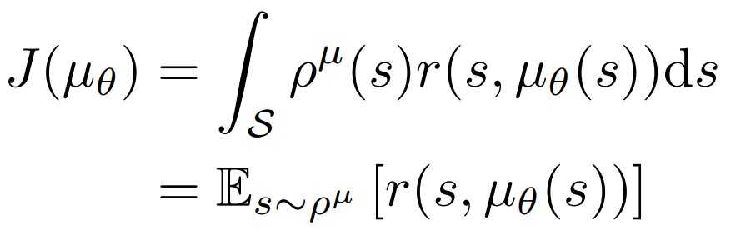
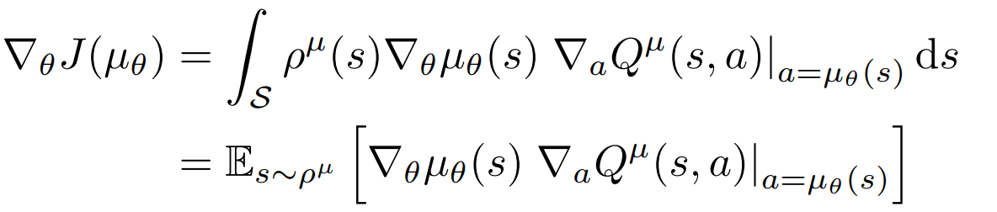
Deterministic Policy Gradient
Objective function:
Policy gradient:
Source: D. Silver, G. Lever, N. Heess, T. Degris, D. Wierstra, and M. Riedmiller. Deterministic policy gradient algorithms. Jan. 2014.

Slide 41
Outline
Outline
Teaser
Introduction/Motivation
Background
Solution
Implementation
Results
Future work and conclusions

Slide 42
RL Algorithms
Q-Learning
State-Action-Reward-State-Action (SARSA)
Deep Q-Network (DQN)
Stochastic Policy Gradients (PG)
Deterministic Policy Gradients (DPG)
Deep Deterministic Policy Gradients (DDPG)

Slide 43
Deep Deterministic Policy Gradient Method (DDPG)
Model-free, off-policy, actor-critic strategy derived by Lillicrap et al.
Based on the Silver et al.’s DPG algorithm combined with learnings from Mnih et al.’s work on the DQN algorithm.
Highly flexible algorithm for continuous control.
Notes:
In Lillicrap’s paper, DDPG surpassed DPG performance in over 25 OpenAI environments without any network or hyperparameter changes. In some cases, produced a policy surpassing a planning algorithm with full access to underlying physical models and derivatives.

Slide 44
DDPG Key Features
Actor and critic represented by ANNs
Experience replay
Target networks for actor and critic
Batch normalization
Exploration noise
Notes:
Actor and critic represented by ANNs, from DPG and DQN
Experience replay from DQN
Target networks for actor and critic from DQN. Four networks in total.
Batch normalization, allows hyperparameter generalization from Ioffe’s work
Exploration noise ensures sufficient exploration despite actor following policy

Slide 45
Outline
Outline
Teaser
Introduction/Motivation
Background
Solution
Implementation
Results
Future work and conclusions

Slide 46
Implementation
Python 3.6
TensorFlow
OpenAI Gym
Pyglet

Slide 47
Outline
Outline
Teaser
Introduction/Motivation
Background
Solution
Implementation
Results
Future work and conclusions

Slide 48
Outline
Outline
Teaser
Introduction/Motivation
Background
Solution
Implementation
Results
Future work and conclusions

